Slide 1
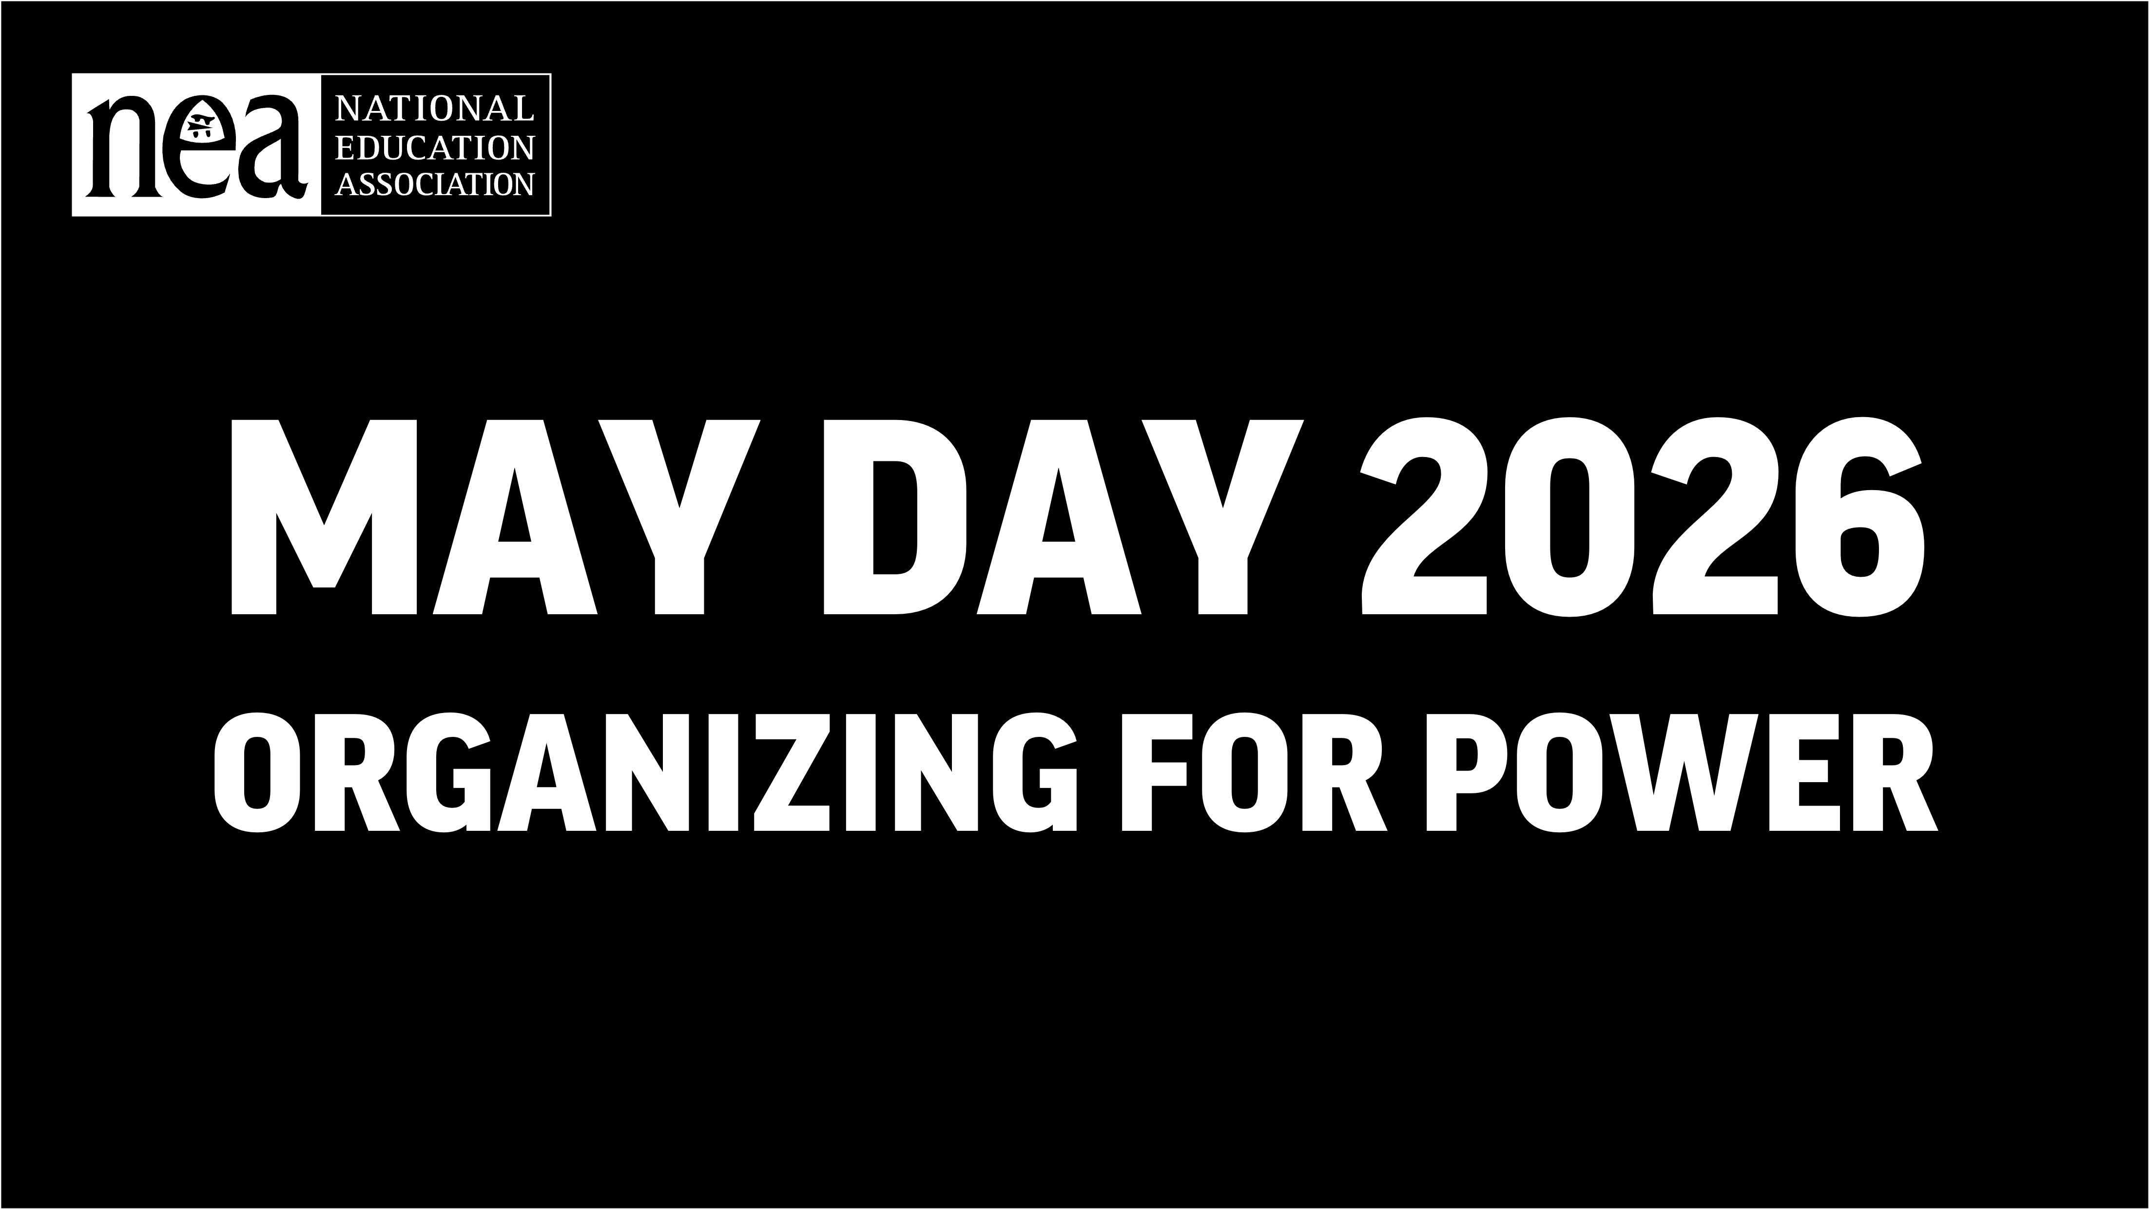
MAY DAY 2026
ORGANIZING FOR POWER
Notes:
Add your local and state union logos, too!​

Slide 2

MAY DAY 2026: ORGANIZING FOR POWER
Agenda
Welcome
What do you know about May Day?​
History
What’s May Day or International Workers’ Day?
What has our union done for May Day?
Where we find ourselves
How do we build for May 1, 2026?

Slide 3
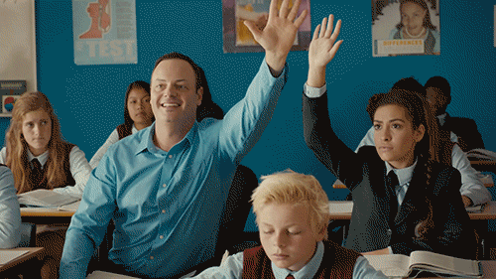
MAY DAY 2026: ORGANIZING FOR POWER
What do you think of when you hear the words "May Day"?​

Slide 4
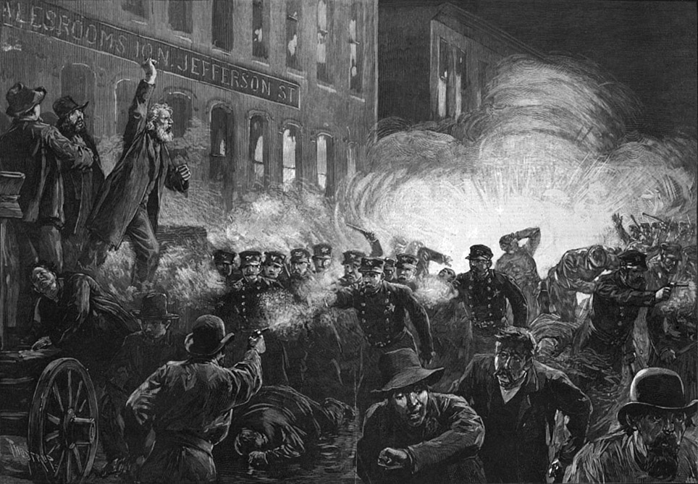
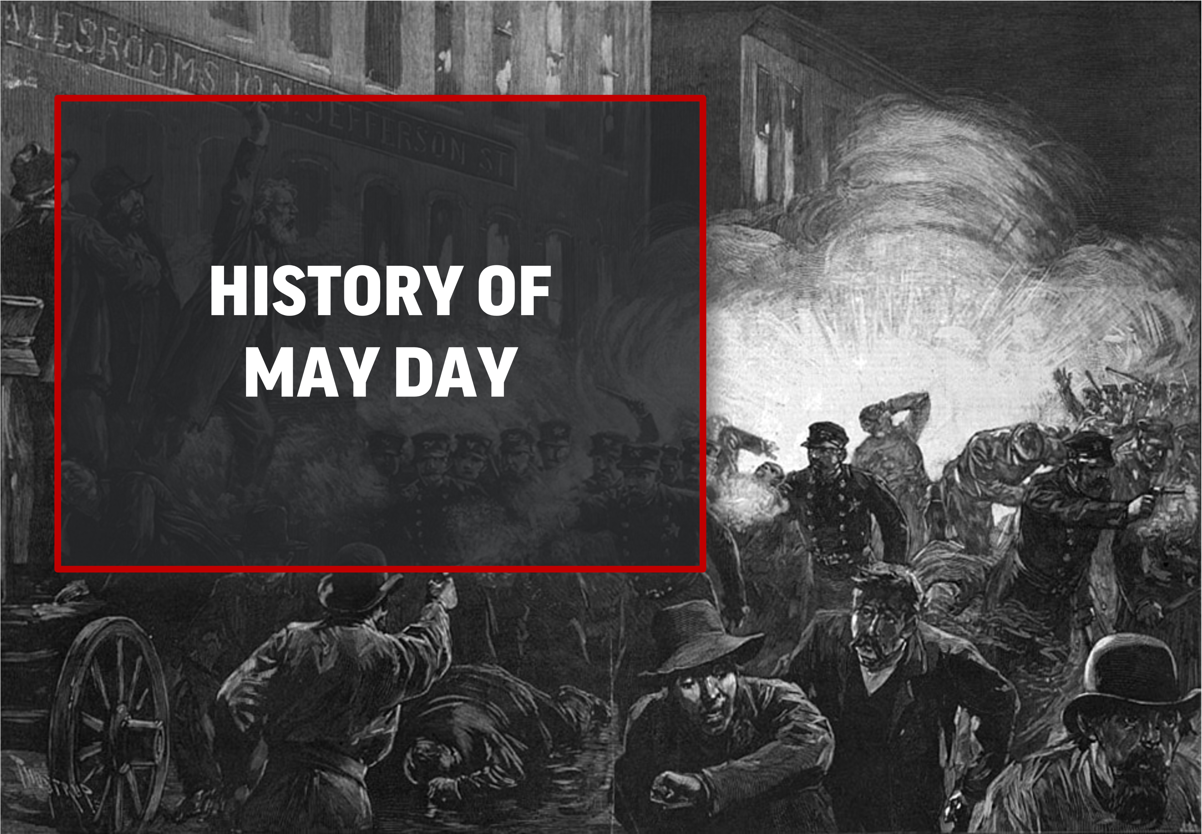
HISTORY OF MAY DAY

Slide 5
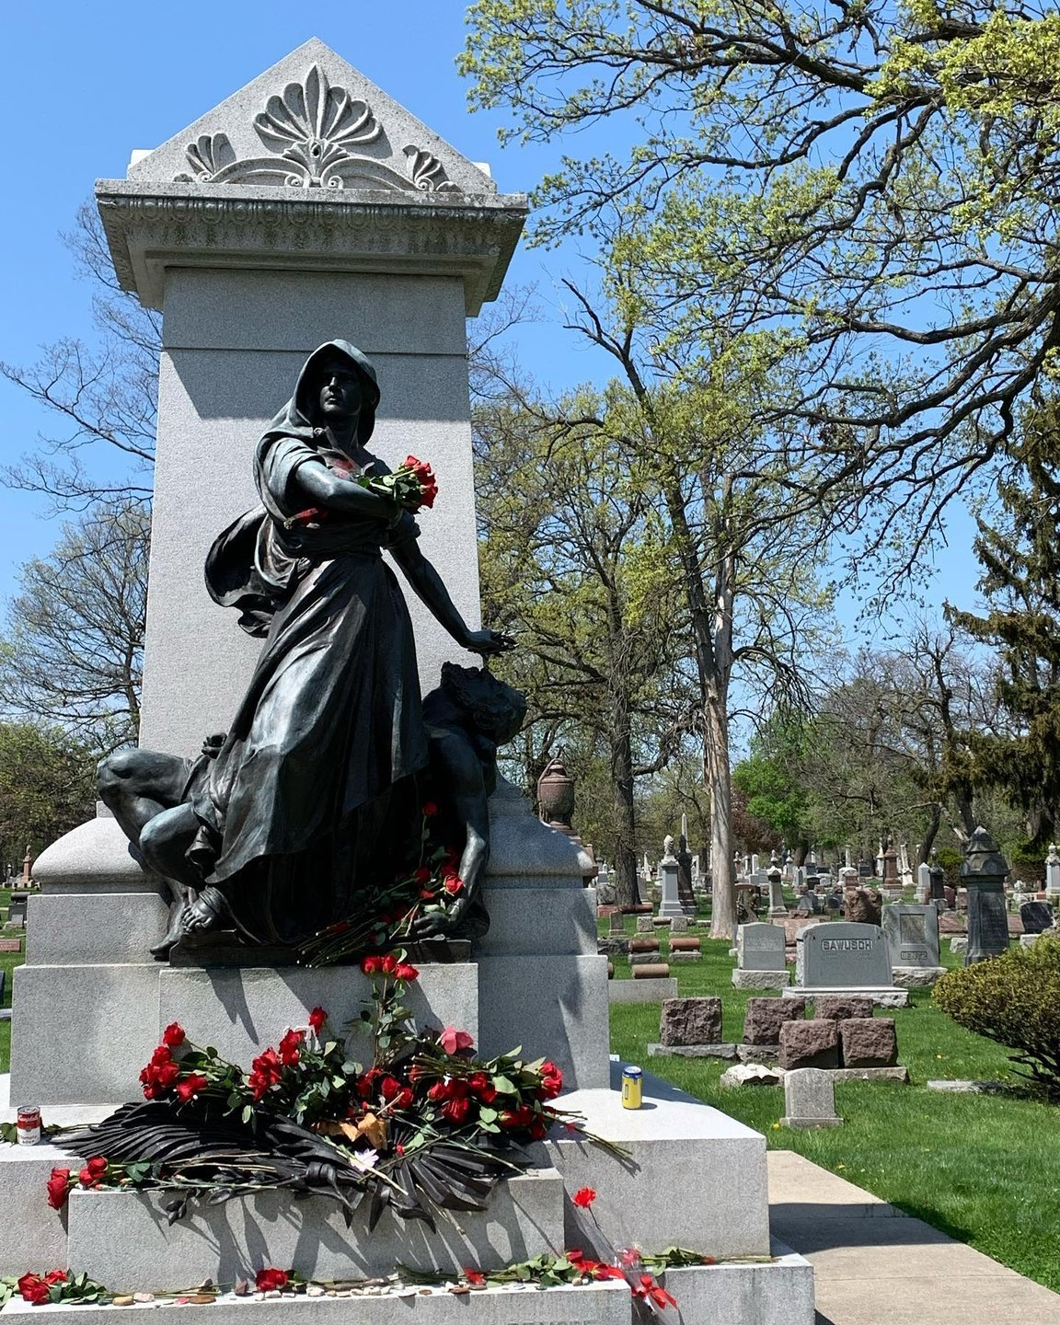
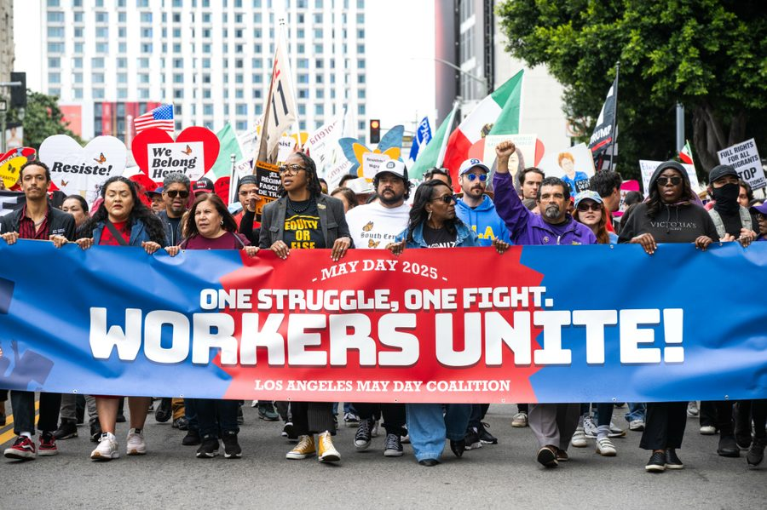
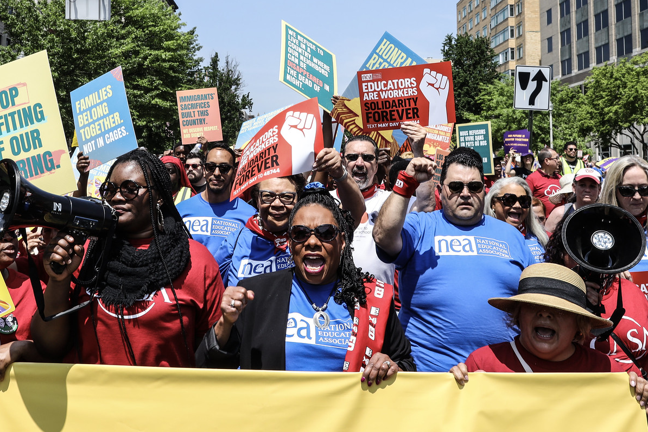
MAY DAY 2026: ORGANIZING FOR POWER
What’s May Day?
May Day = International Workers’ Day
Born from U.S. labor struggles and carried forward by workers worldwide
Educators are Workers
Our classrooms, campuses, and workplaces reflect the value society places on workers.
Solidarity is how we win!
It’s past time to prioritize workers over billionaires
LORUM IPSUM
Notes:
Presenter note (not read aloud): This is a labor story. Deliver it with conviction. You are speaking as a worker, not a guest.
Weaving in Local Labor History
Why this matters: May Day is strongest when people see themselves in it. National stories like Haymarket and Blair Mountain set the frame—but local labor history makes it real.
Before You Present
Do 5 minutes of homework. Look up:
A local strike, walkout, or organizing win
A school closure fight, desegregation struggle, or a bargaining breakthrough
A major employer or industry that shaped your community
You don’t need details—one sentence is enough.
How to Add It to the Script (Without Rewriting Everything)
Use a brief bridge like:
“That history isn’t abstract—right here in [city/region], workers…”
“In our own community, educators and workers have had to fight for…”
“This town knows what labor struggle looks like…”
Then add one concrete example, and move on.
What Counts as “Labor History” for Educators
Not just factories or mines. Examples include:
Teacher strikes or sickouts
School integration or desegregation fights
Battles over class size, safety, or pay
Bus drivers, cafeteria workers, and custodians organizing
Public-sector workers winning collective bargaining rights
If it involved risk, retaliation, or organizing, it counts.
If You Don’t Know the History
That’s okay. Try:
“Every community has a labor story—even if we’re still uncovering ours.”
“The struggle didn’t start with us, and it won’t end with us—but we’re part of it.”
---
Script (read or adapt):
May Day, International Workers’ Day, wasn’t handed to us by anyone in power. We won it. That fight started right here in the United States, in Chicago in the 1880s, when workers, many of them immigrants, demanded something radical for the time: an eight-hour workday. They believed working people deserved time to live, not just survive.
At Haymarket Square, that demand was met with brutal repression: violence, arrests, and executions. Instead of silencing the movement, it lit a spark. That spark grew into a global tradition of resistance and solidarity that workers around the world still carry forward every May 1.
There’s a reason May Day isn’t officially recognized in this country. It reminds those in power what happens when working people organize and refuse to stay quiet.
From Haymarket to Blair Mountain, from the Flint Sit-Down Strike to the sanitation workers in Memphis, every gain working people have made came through collective struggle. Workers faced police violence, private militias, prison cells, blacklists, and worse. And still, they organized. Those fights aren’t just history lessons. They’re alive today in every contract campaign, every picket line, every strike vote, and every moment someone chooses solidarity over fear.
And let’s be clear: as educators, we are workers. Our classrooms and campuses are workplaces. Our working conditions are our students’ learning conditions. When politicians and billionaires underfund public education, weaken unions, and treat educators as disposable, they’re attacking our communities.
Right now, all across the country, from fruit fields in California to classrooms in Chicago, from kitchens in Queens to loading docks in Atlanta, working people are standing up together. NEA members are linking arms with laborers, parents, students, immigrants, and neighbors to demand dignity, justice, safe communities, and real investment in people, not billionaire profit margins.
On May 1, we honor the workers who fought, bled, and died at Haymarket, at Blair Mountain, and everywhere in between by continuing their struggle. This isn’t symbolic. This is collective action. This is a line in the sand.
We’re turning the page toward a future where working families lead, immigrants are protected, and no one is left behind, and we’re building that future together.

Slide 6
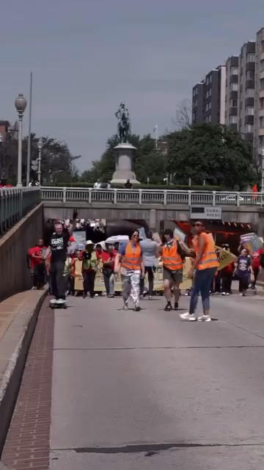
MAY DAY 2026: ORGANIZING FOR POWER

Slide 7
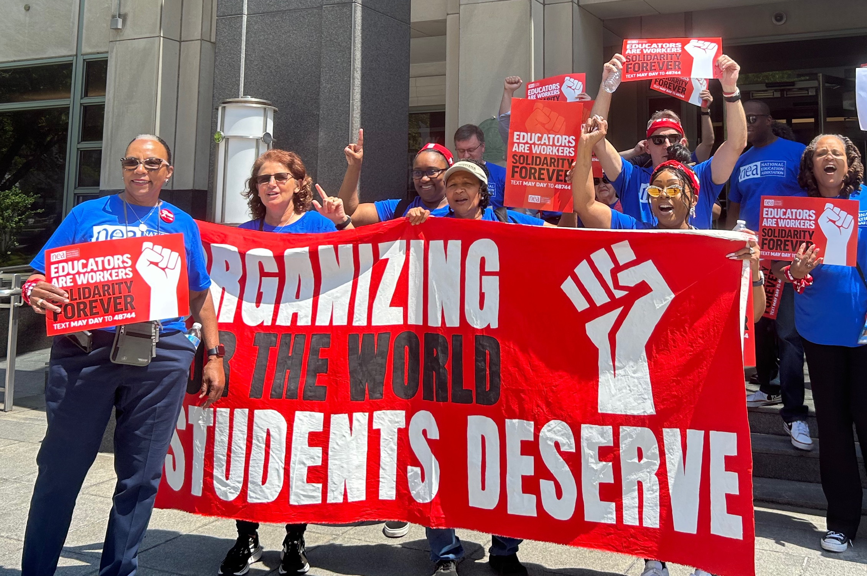
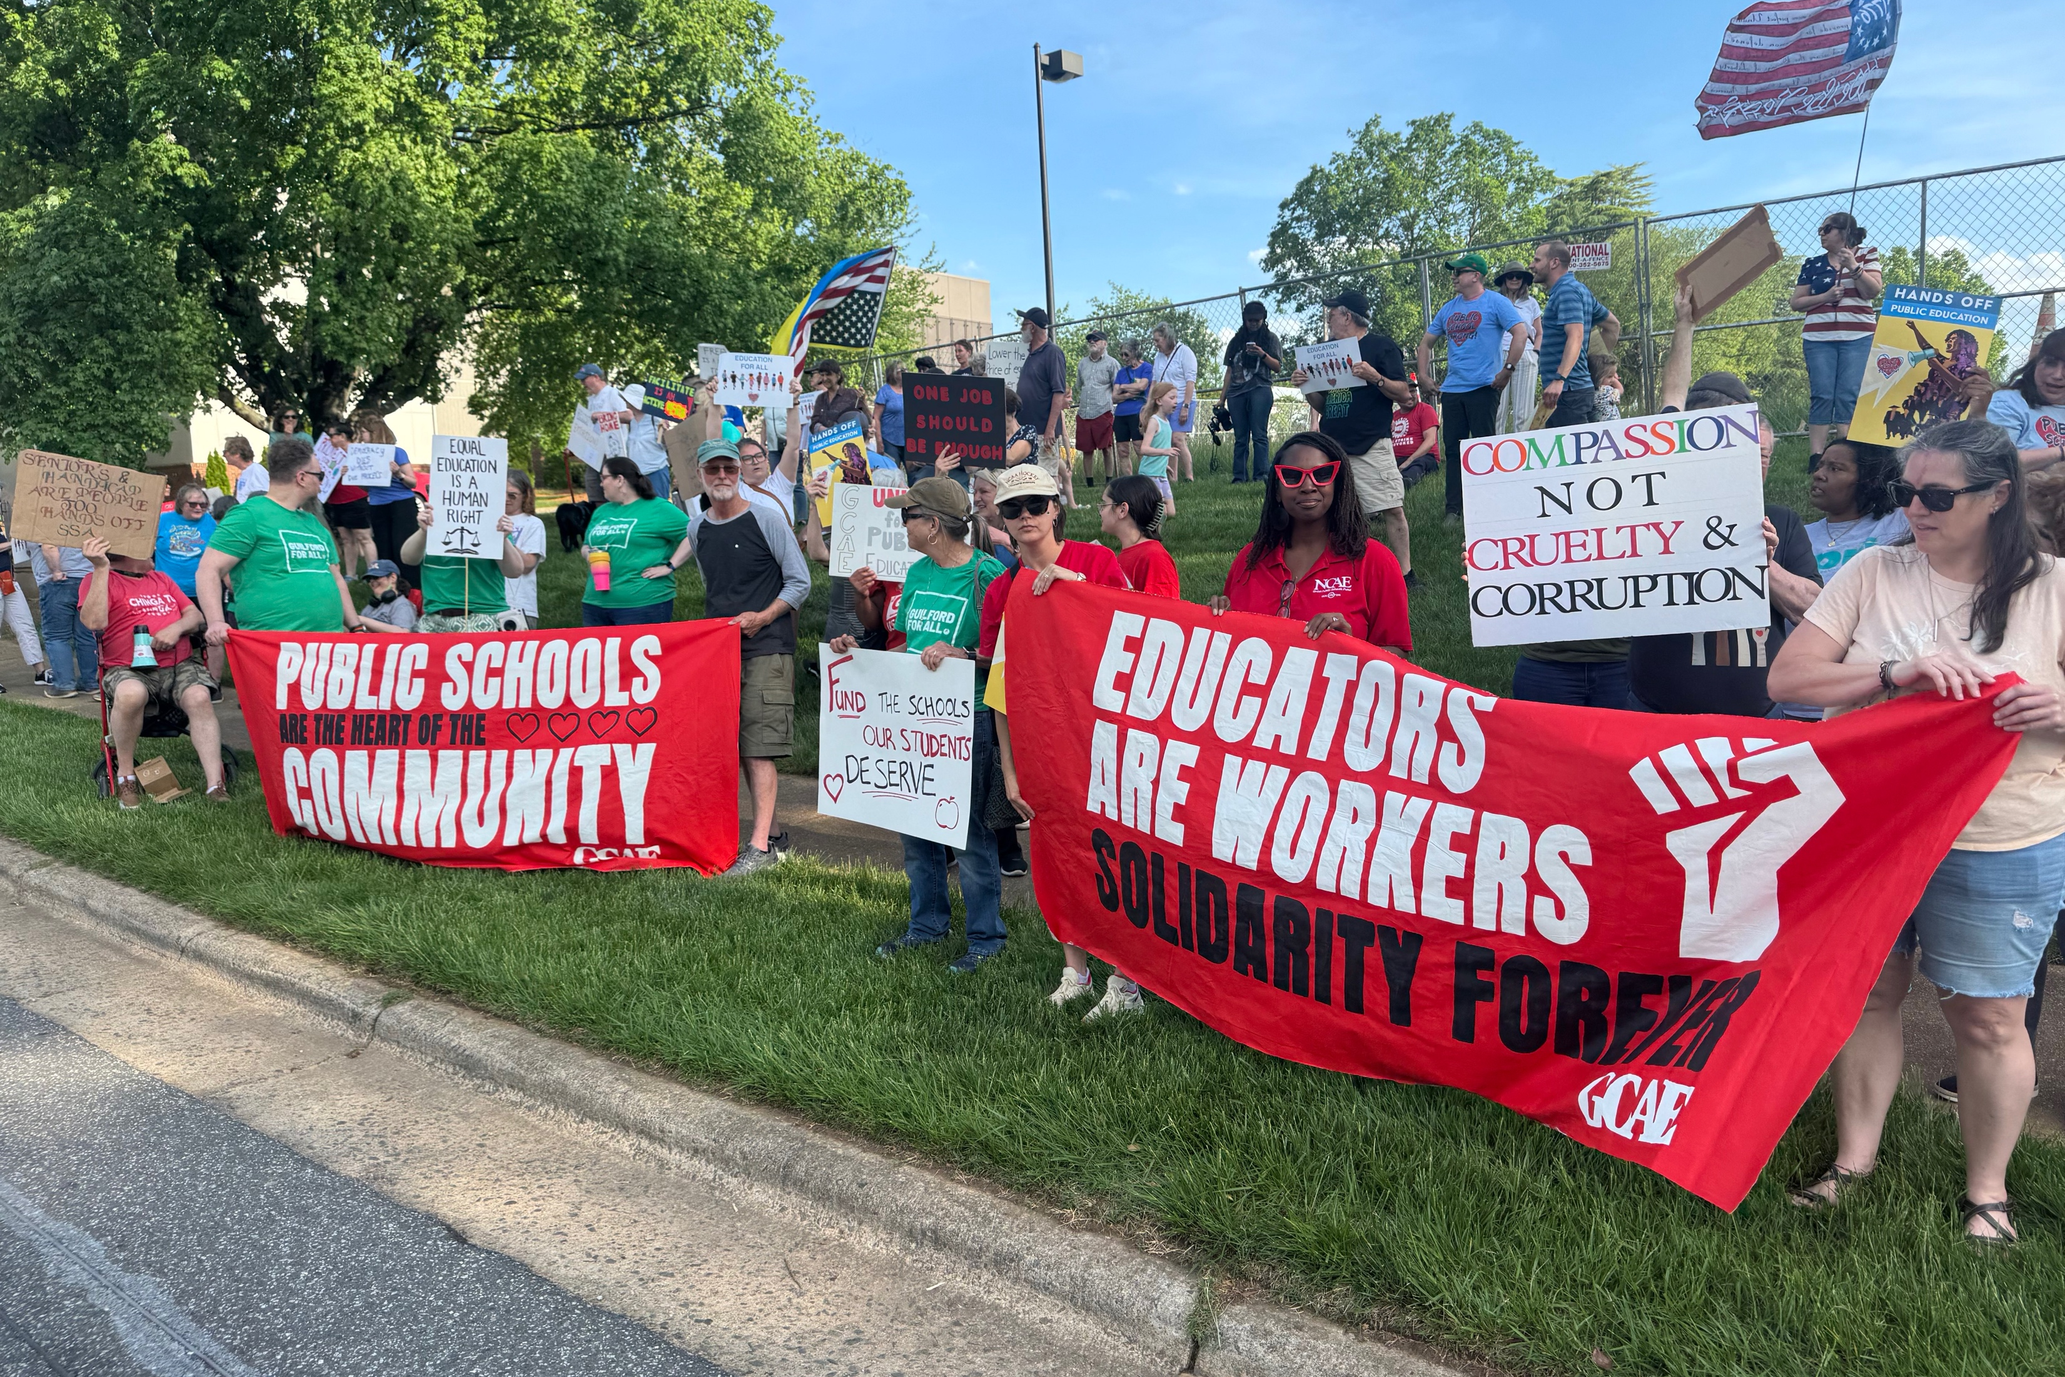
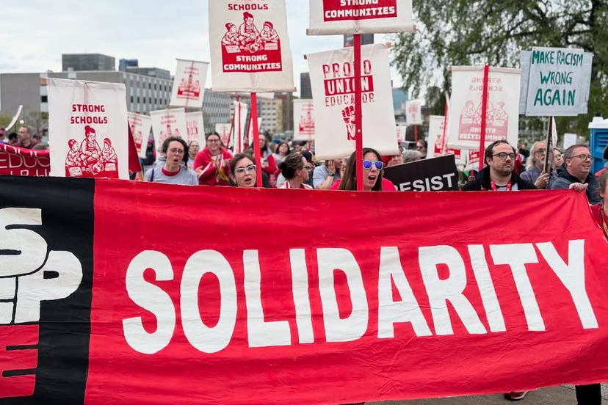
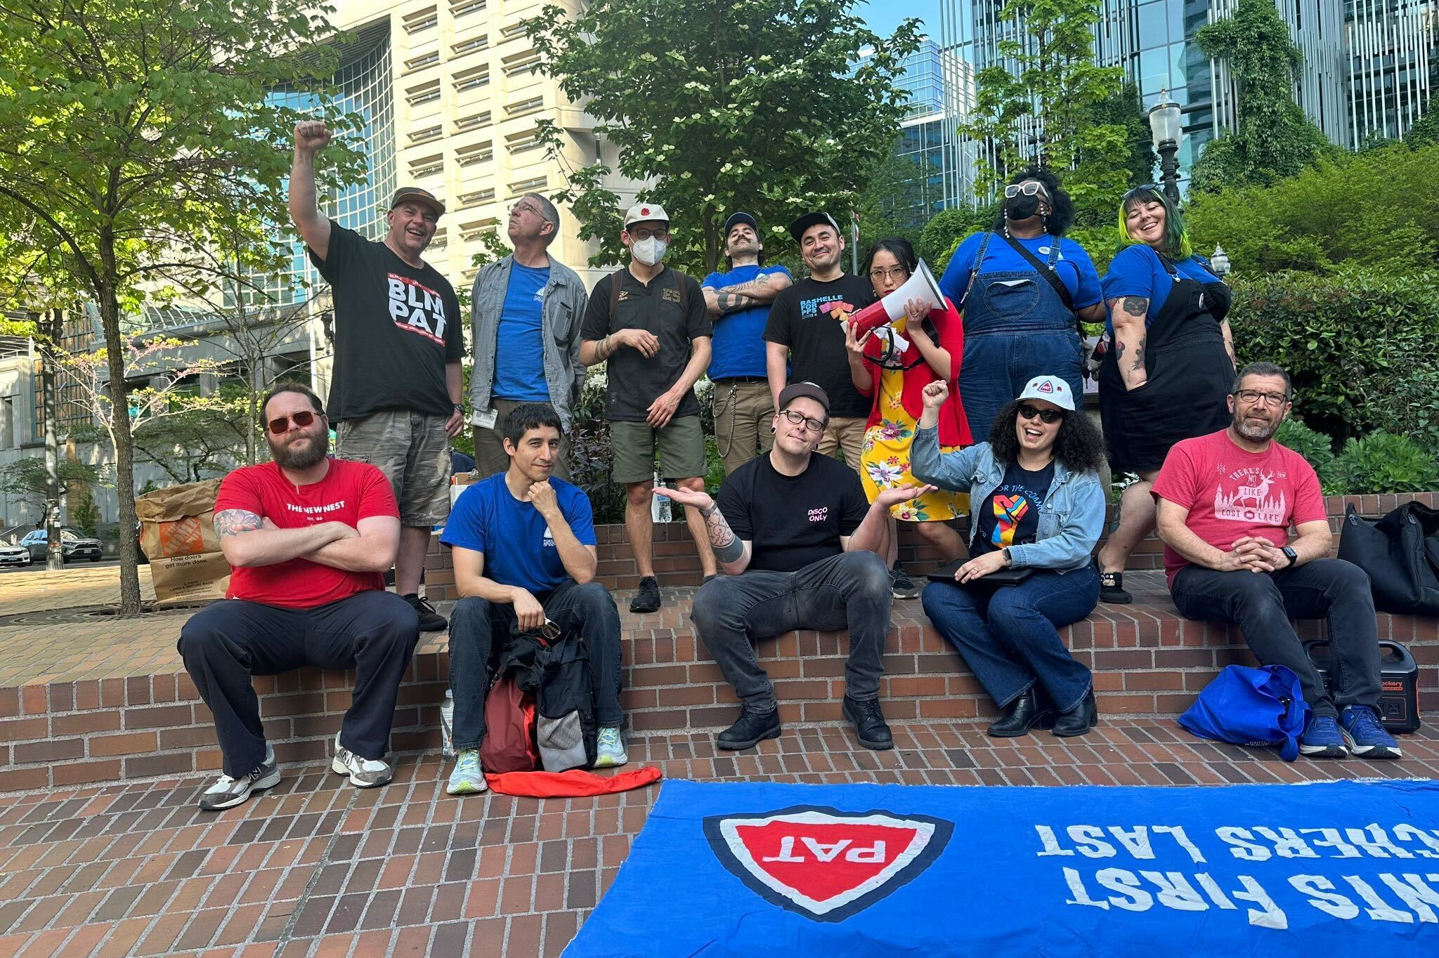
MAY DAY 2026: ORGANIZING FOR POWER
What has our union done for May Day?
May Day March
NEA joined a massive rally in Washington D.C.​
[state/local example if applicable]
May Day Strong Coalition
200+ Organizations & Unions​
1000+ Events​
800+ Cities & Towns
Organizing for 2026 . . .​
It’s past time to prioritize workers over billionaires—solidarity is how we win!​
[Local Name] has a part to play as we organize to grow our movement! ​
LORUM IPSUM

Slide 8
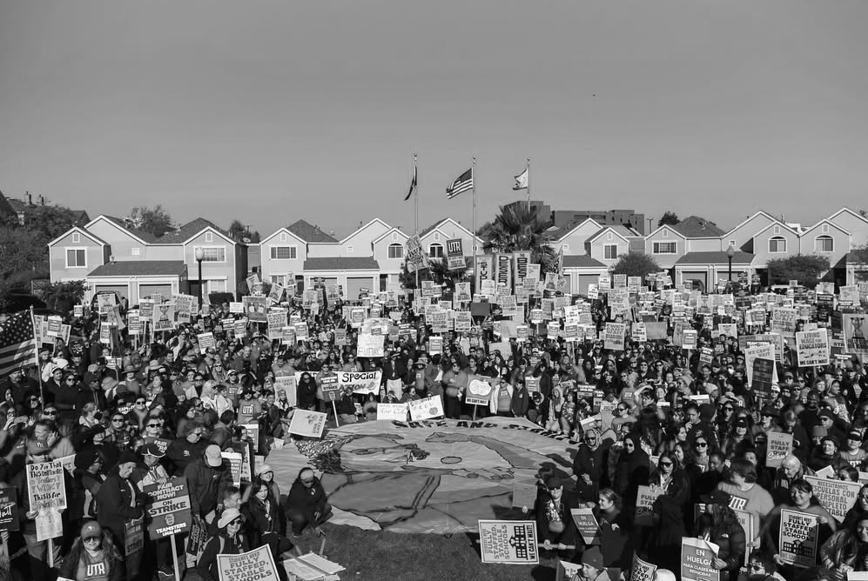
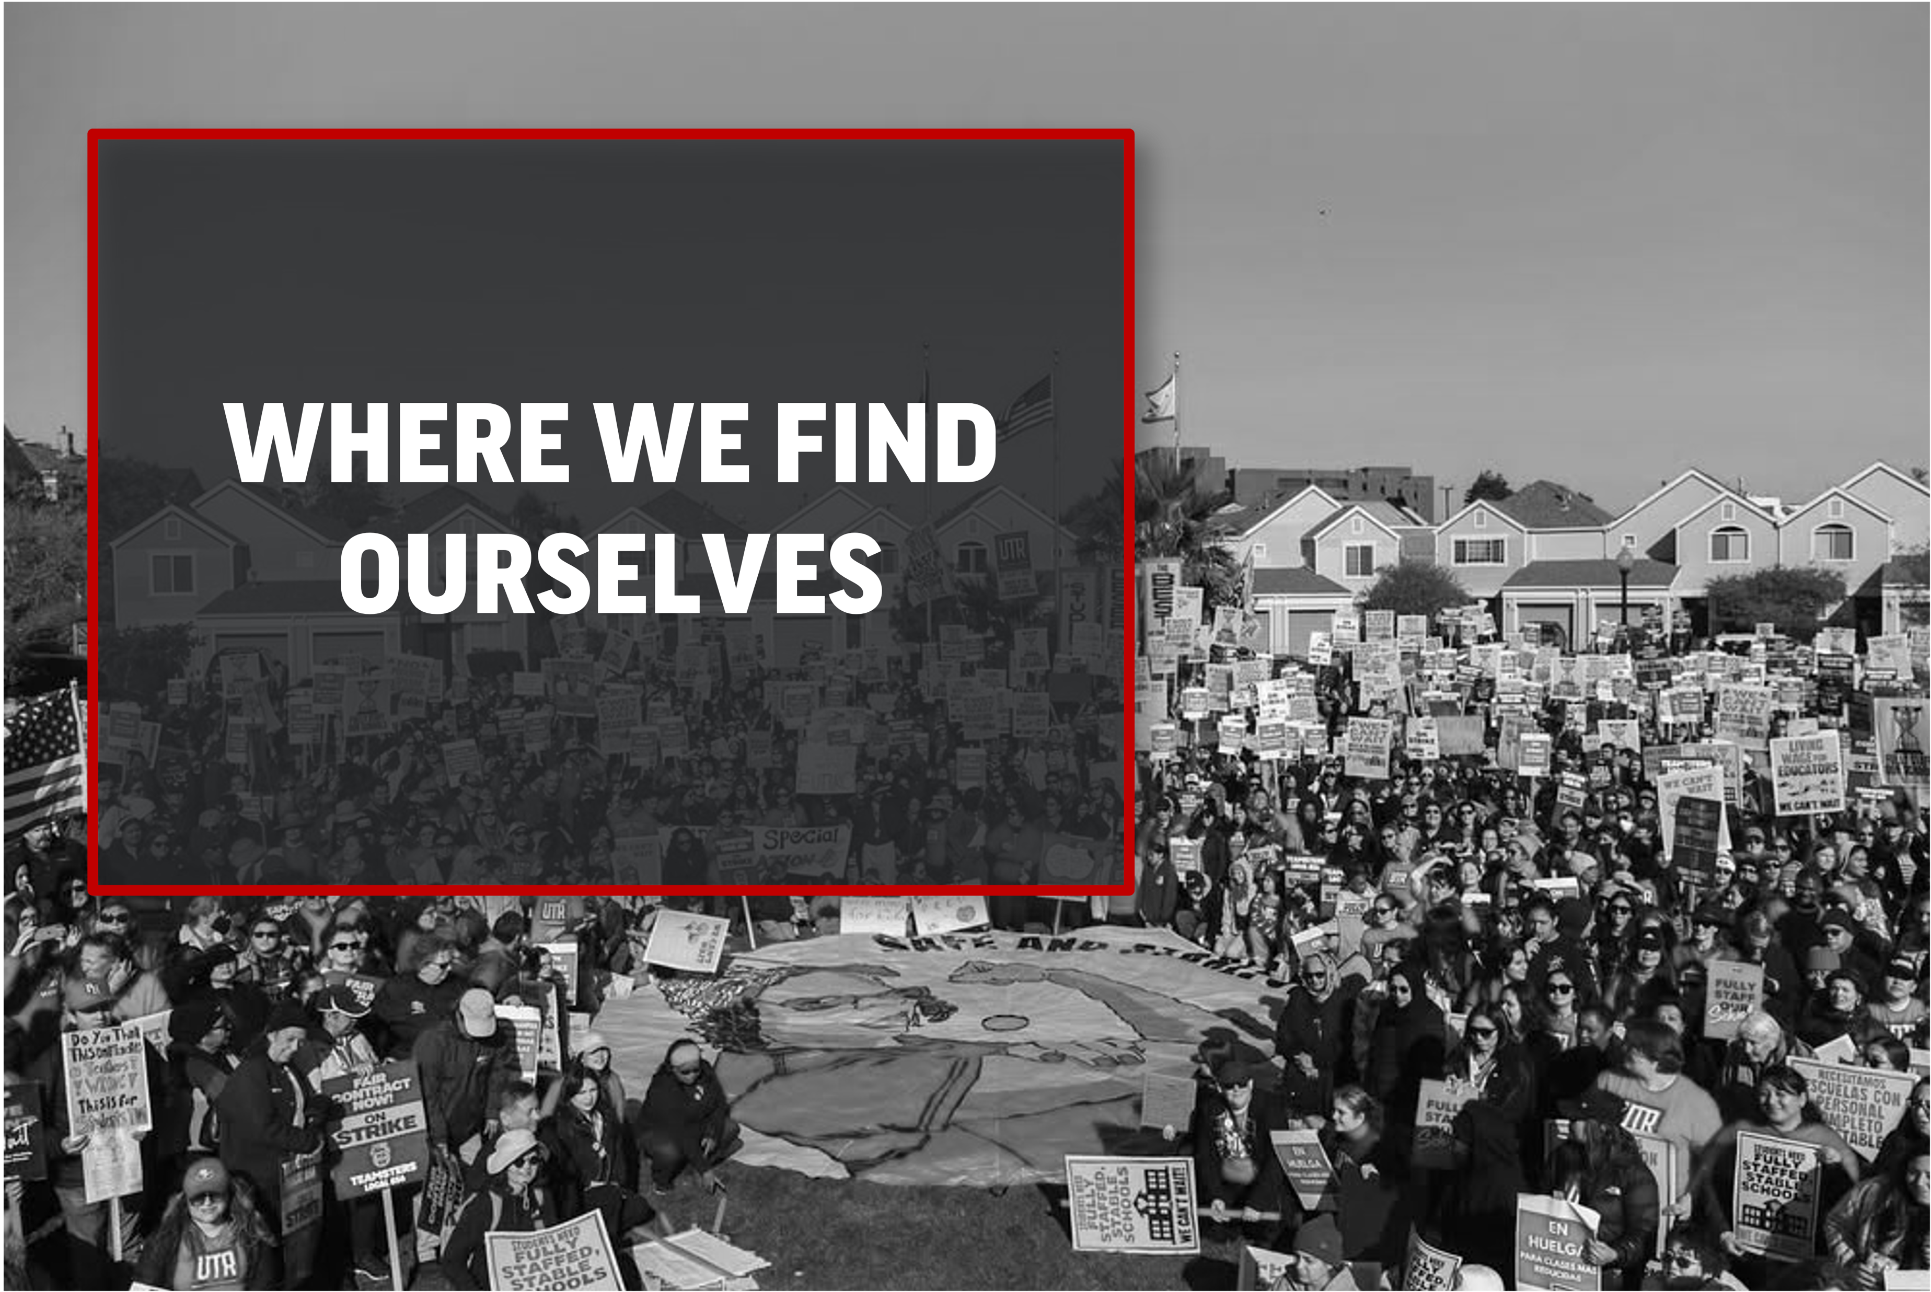
WHERE WE FIND OURSELVES

Slide 9
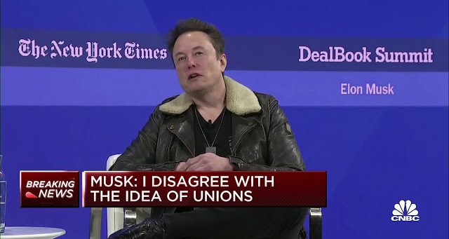
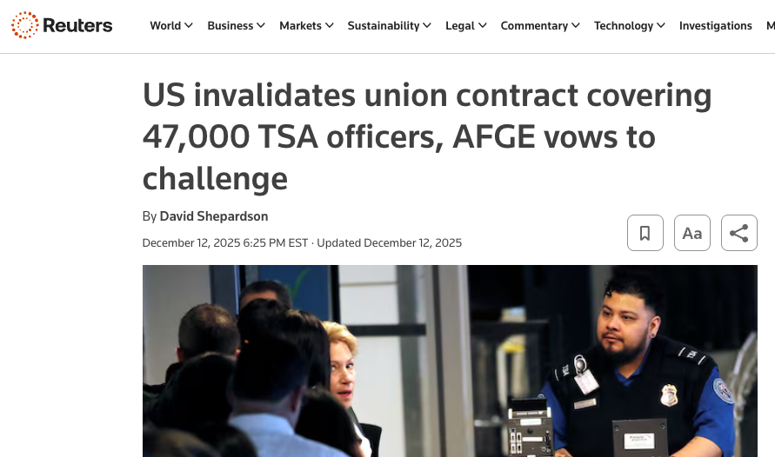
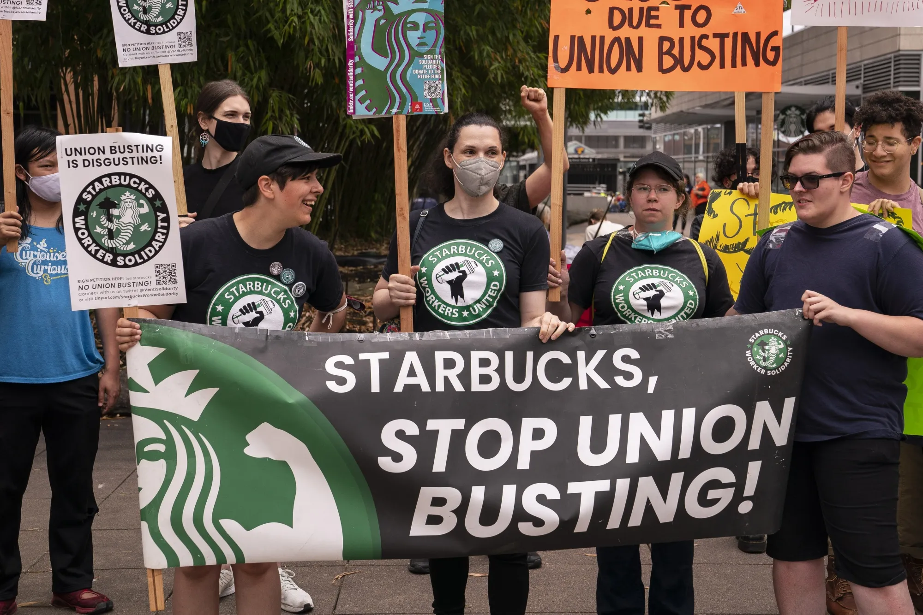
MAY DAY 2026: ORGANIZING FOR POWER
Where we find ourselves
Unions are more popular than ever but billionaires are holding us back​
70% of Americans approve of Labor Unions​
But the number of workers in unions shrank to under 10%
The NLRB, the government watchdog for workers, is understaffed, under-resourced & under attack​
Leads to significant case backlogs and delays—especially with the surge of organizing.
Anti-worker forces are spending millions in elections.
Notes:
NLRB Context (if needed) and Question to the audience.
Context NLRB (National Labor Relations Board): The National Labor Relations Board is an independent federal government agency responsible for enforcing U.S. labor law in the private sector. It oversees union representation elections, investigates unfair labor practice charges, and adjudicates labor disputes between employers and unions under the National Labor Relations Act (NLRA).
The NLRB primarily covers private-sector workplaces. Public-sector workers (such as public schools) are typically covered by separate state labor laws, and some states have their own labor relations boards to handle those disputes.
Question
What is the punishment for breaking labor law? They’re asked not to engage in the illegal activity again through an injunction. They’re fined or might have to pay back pay or something monetary—but more often than not, fines on bosses for breaking labor law are more of an invoice than punitive.
Elon Musk, who will be making more money than every elementary school educator in the United States combined, is suing to argue that the National Labor Relations Board is unconstitutional and disagrees with the existence of unions. He spent more than $200 million in the 2024 election, supporting anti-worker candidates. That’s more than the 2004 election altogether. That’s also equivalent to the average educator spending $36 of their own money on elections.

Slide 10
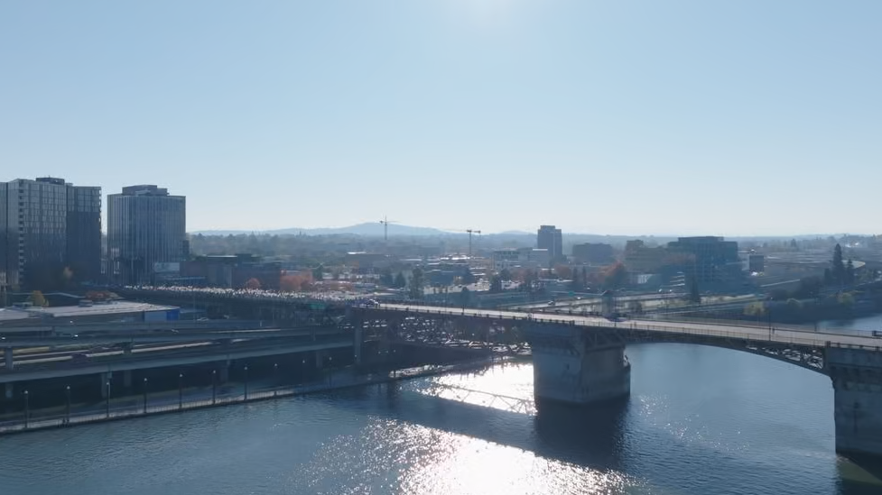
MAY DAY 2026: ORGANIZING FOR POWER
How we fight back
Organized people vs. organized money
The billionaire class has wealth and influence; working people have numbers, relationships, and the ability to act together
Power grows through solidarity, our stories, and our actions!
When we name the injustice, identify who benefits, and invite people into collective action, we shift the balance of power!
May Day is about testing our ability to organize
Not every action is HUGE, but every movement starts somewhere

Slide 11
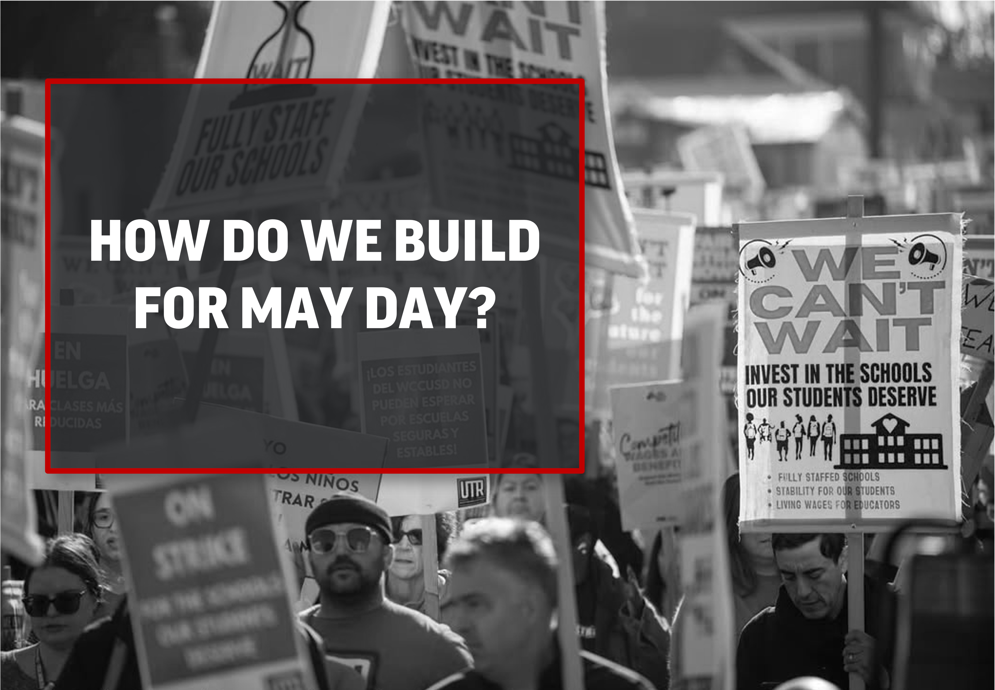
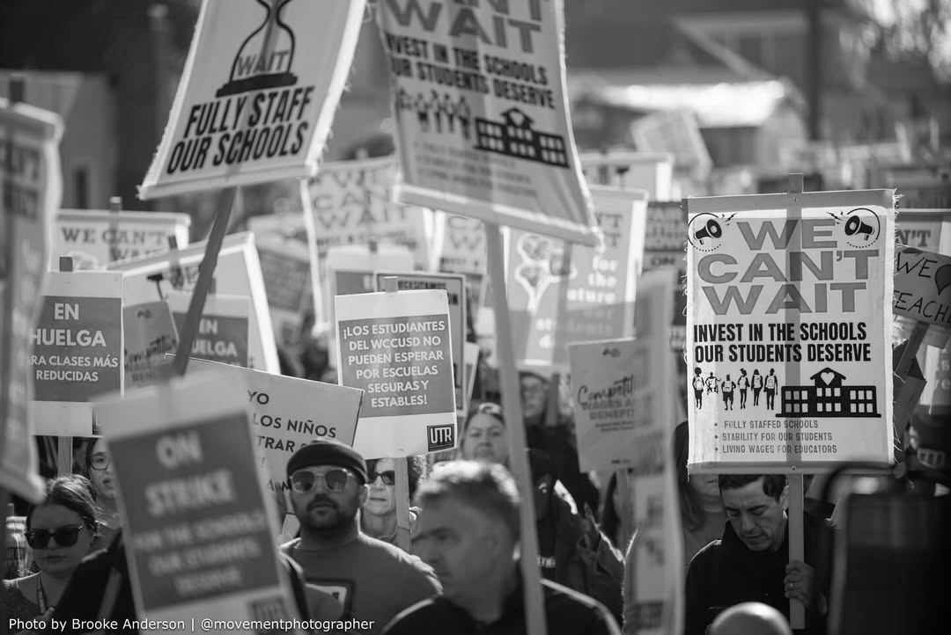
HOW DO WE BUILD FOR MAY DAY?

Slide 12
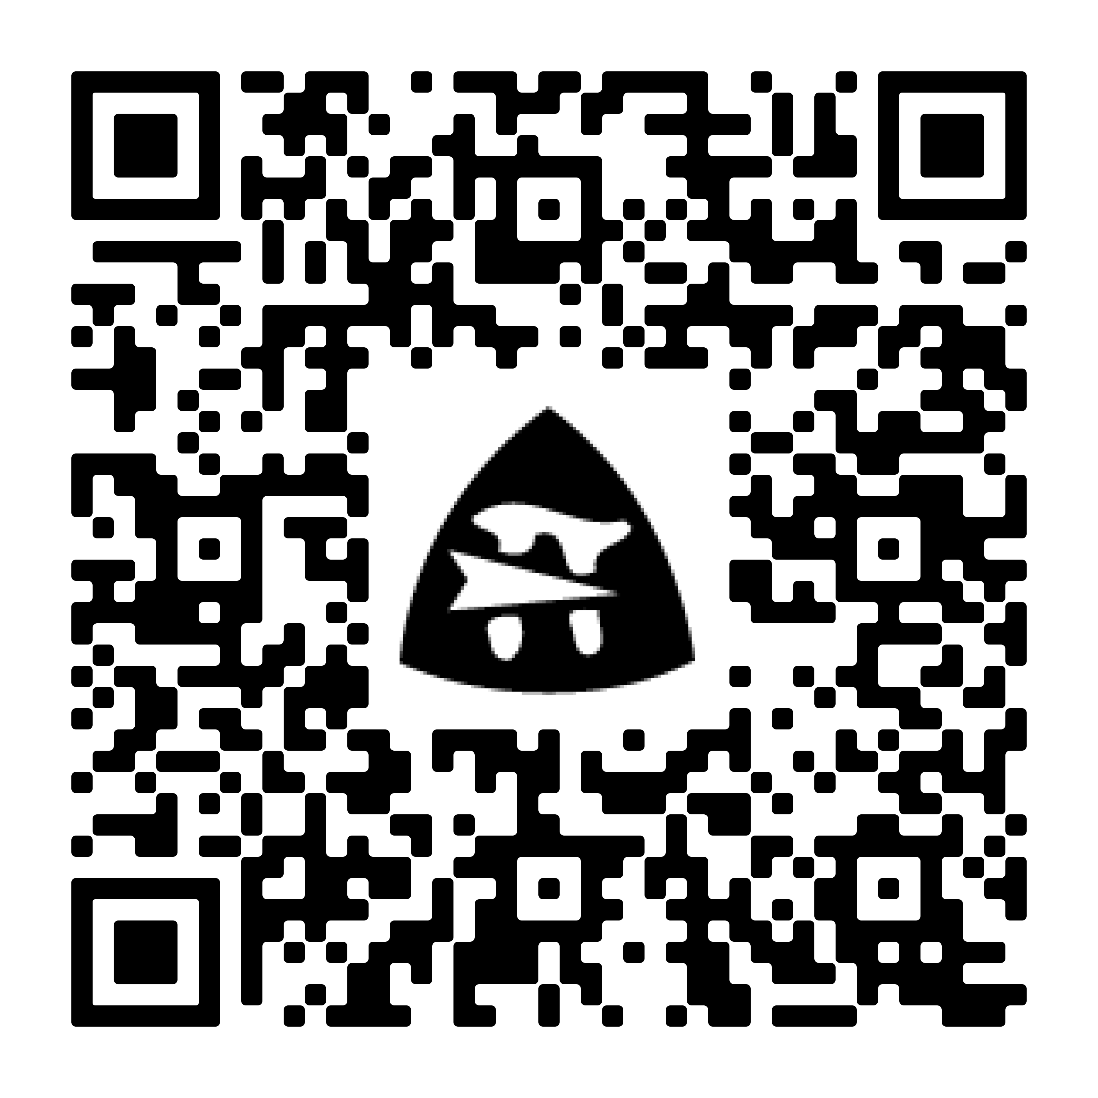
MAY DAY 2026: ORGANIZING FOR POWER
How do we build for May Day?
Let us know you’re interested!
This spring, NEA, locals like ours, and allies will be sharing different opportunities
Host or Join a May Day Event​
NEA has a ton of resources for us to get started at NEA.org/MayDayToolkit
Spread the word!
This movement doesn’t work unless WE step up
Notes:
If your local has already determined how you'll participate, you may want to adjust the second bullet to fit. ​
​
You can also add sub-bullets if your local or building has specific asks (ex: Sign up to make signs for the rally, Sign-up to carpool from our building, Help write or lead chants, etc.).​

Slide 13

Questions?
Notes:
You can add your local and state union logos, too!​

